Slide 1


Smart City Improvements for Environmental Health in San Diego
Team 206: ET’s NU Analytics Geeks
National University Data Science & Business Analytics
Bains, Bala Lnu, Fayankinnu, Gao, Lena, Potluri, Somkul, & Vanderbilt
Notes:
Thank you for providing us the opportunity to present our project to you today. We’re “ET’s NU Analytics Geeks, Team 206” from National University, and we’re here to discuss our Smart City Improvements for Environmental Health. A day before this Hackathon first met, BBC World News reported on new research identifying air quality hazards at schools resulting from parents’ idling their vehicles in the morning and afternoon. In addition to causing respiratory issues, research has linked learning difficulties directly to air quality. This was the start of our project idea to leverage big data to make schools smarter by providing app that would leverage predictive analytics to statistically determine when air quality levels may be unsafe for school children to be outside. What we found, however, was there is simply not enough finite air quality collected in San Diego to make meaningful, location, predictions.
The most innovative products on the market today, from restaurants to consumer goods, are providing complete market chain information, but we have no data to learn about the air we breathe.

Slide 2
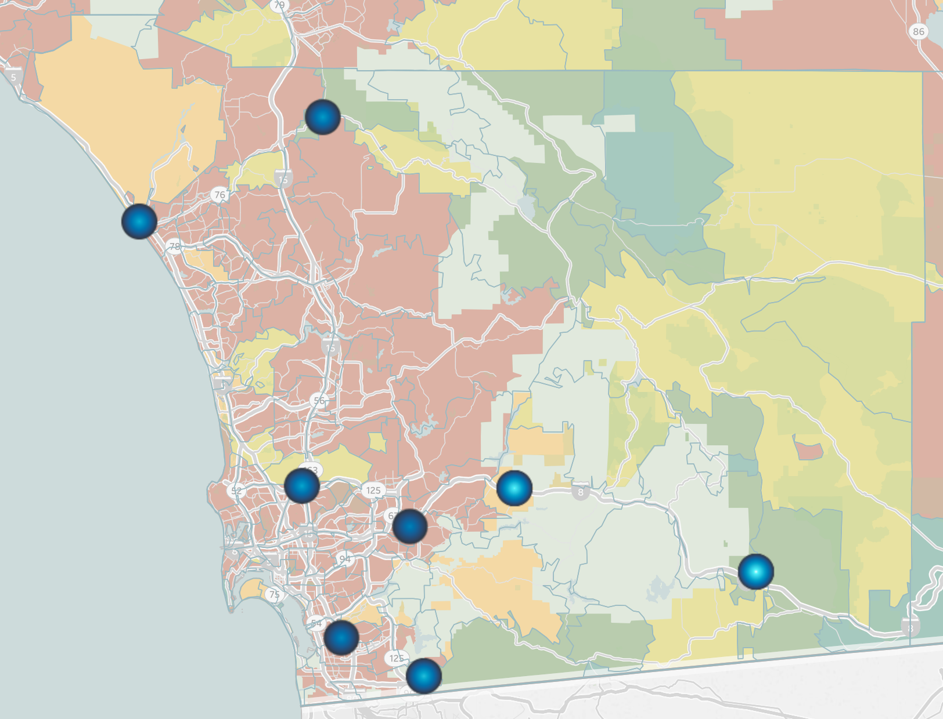

San Diego has Insufficient Air Quality Monitoring for Finite Analytics
Tableau® Mapping of EPA Monitoring Sites vs Population
Sources: EPA AirData Query – San Diego County Data Mart
National Center for Education Statistics Search for San Diego Public Schools (2019)
SANDAG as reported in San Diego County Fact Sheet
Tableau® logo copyright Tableau Software.
Notes:
To put this in perspective, there is a public K-12 school every 5.7 square miles in San Diego County, but the EPA has air quality monitors only every 710 square miles.

Slide 3
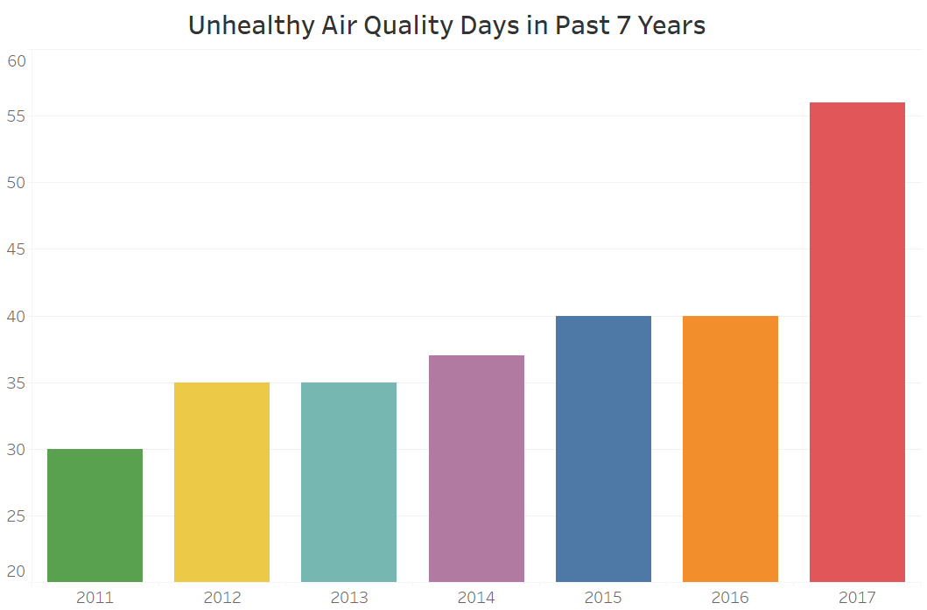
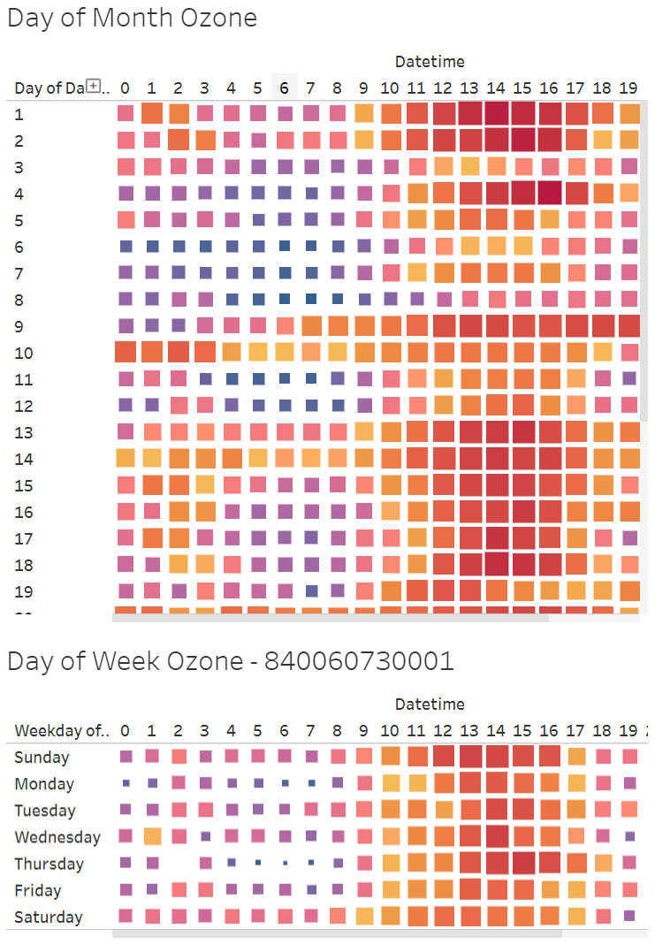
Prevalence of Unhealthy Air Quality Days in San Diego is Increasing
Days Air Quality Deemed Unhealthy for Population, 2011-2017
Mean Ozone by Day of Month
56
Problem: Increasing Air Quality Health Risks
Number of Days
40
40
37
35
35
30
Mean Ozone by Day of Week
Year

Slide 4
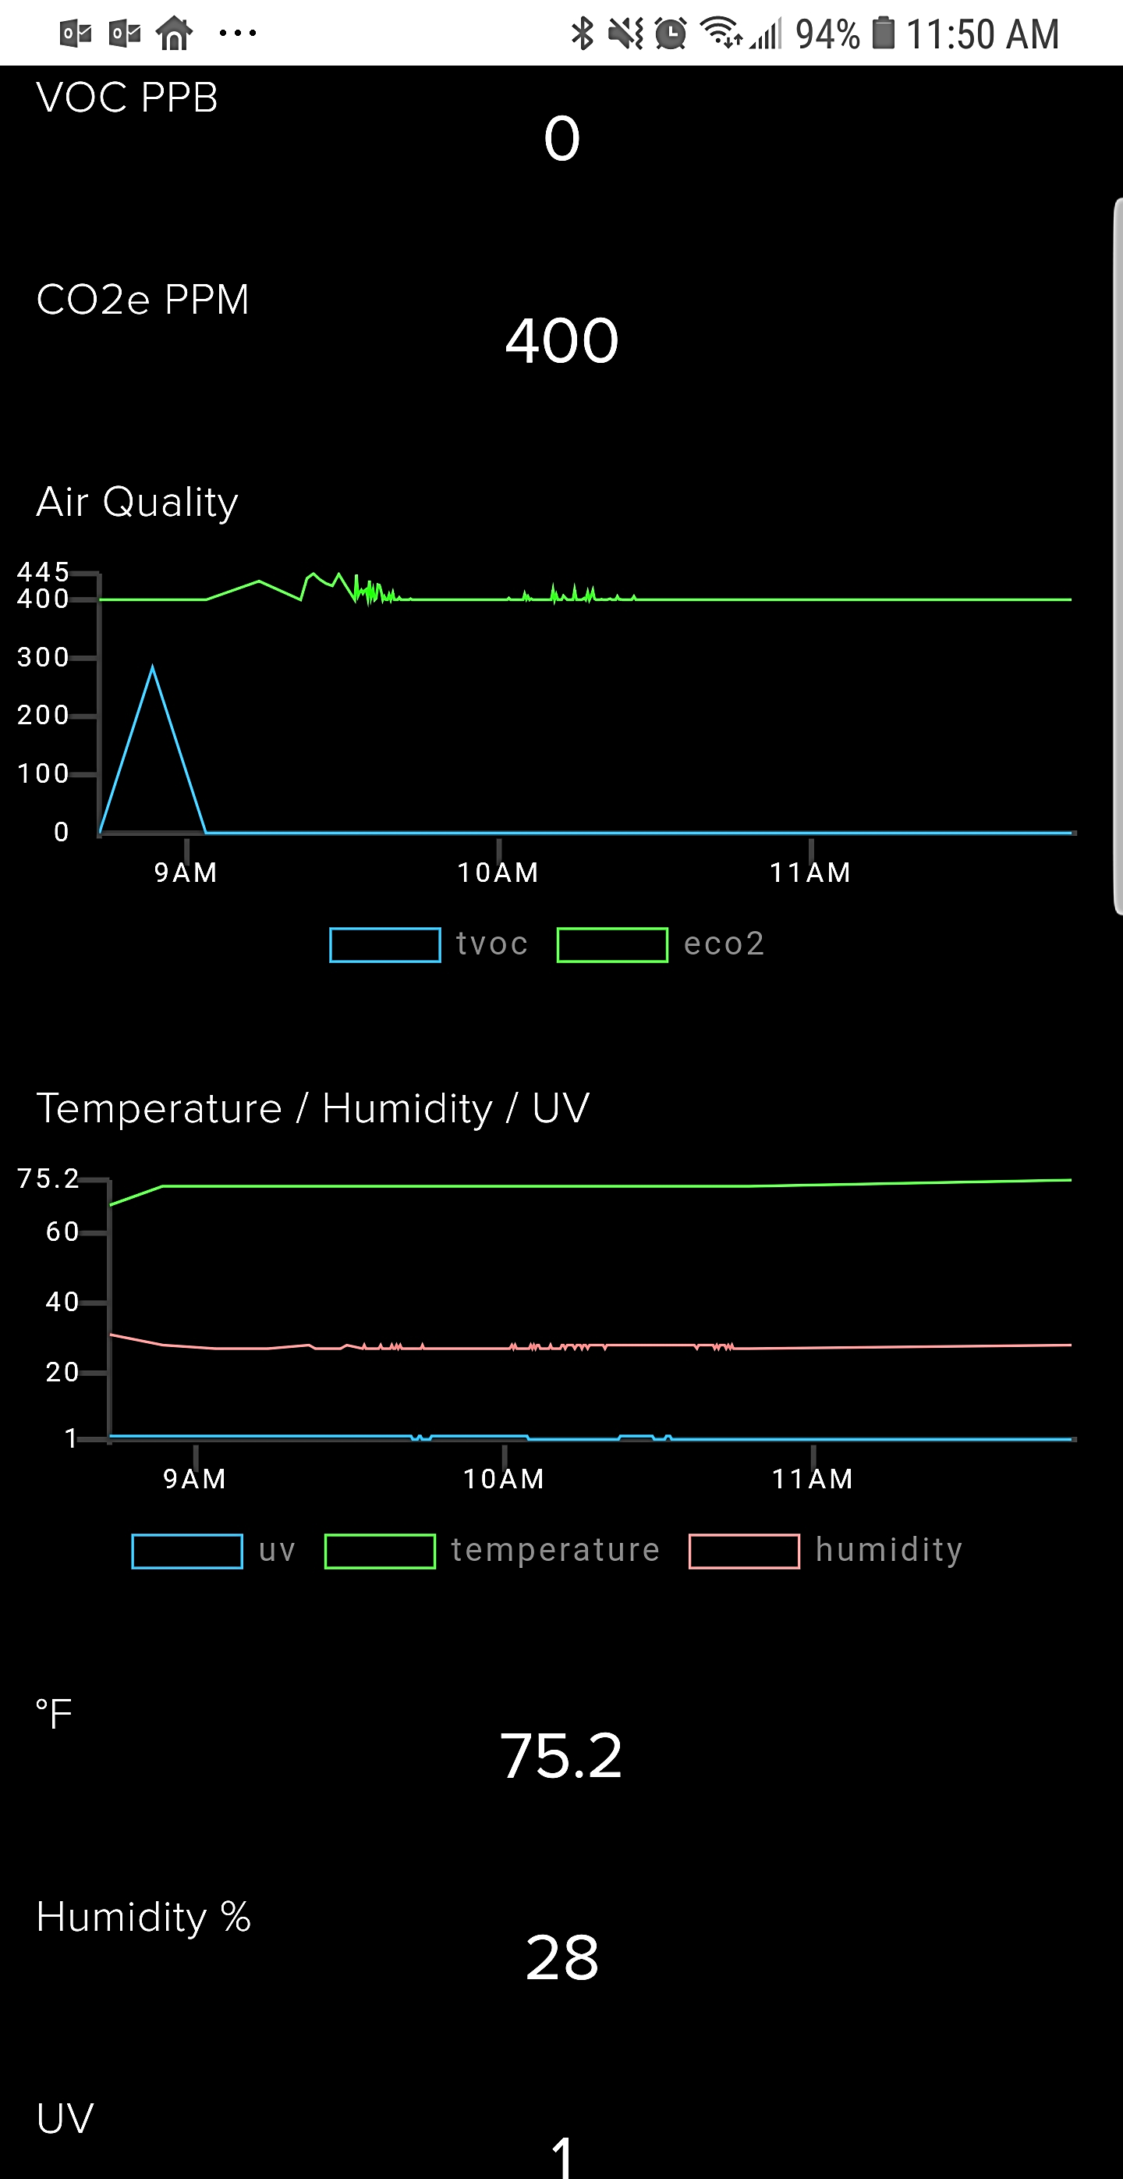
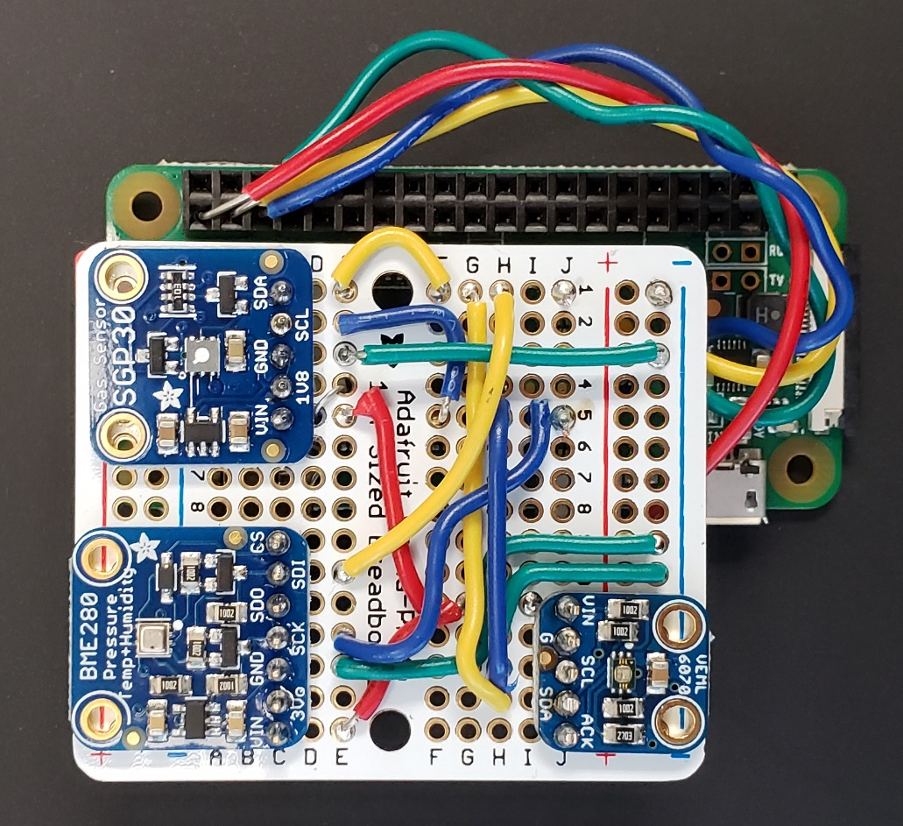
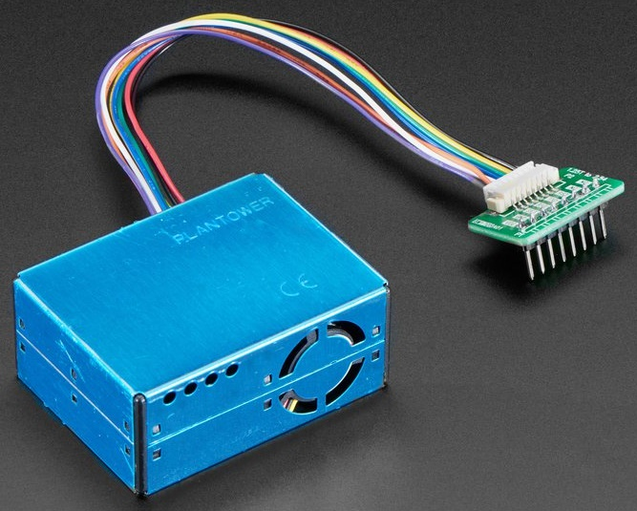
Low-Cost Sensor Provides Real-Time Air Quality Monitoring
Spare Parts Prototype
Cost Effective
Massively Scalable
Readily Deployable
Wi-Fi
Easily Accessible
Preliminary Predictive Algorithm
$$AQI=−7.72+0.69 Ozone+0.61 PM2.5+ε$$
$$r^{2}=0.90 | P<2.2e^{−16}$$
PPM2.5 Image Copyright Adafruit
Notes:
Using spare parts that retailed for about $60, we built this Wi-Fi-enabled device based upon the Adafruit Environmental Monitor. It reads multiple environmental data points every five seconds to determine indoor/outdoor air quality, and uploads that information to the Adafruit IO server. An optimized device such as this will be inexpensive to produce, massively scalable across the City and County of San Diego, and is readily deployable en masse. This is not a high-precision device such as

Slide 5



















Distributed Data Gathering for Predictive Modeling Algorithm
© 2019 paulrommer – Adobe Stock
Distributed Big Data Gathering
Real-Time Processing
Supervised Machine Learning
Actionable Reporting
© 2019 Africa Studio – Adobe Stock
Logos copyright Adobe Stock
Notes:
Linear regression has statistically significant model through ozone and PM2.5 only, so additional monitoring is not beneficial.

Slide 6








References & Tools Used
(2019). "AQS API / Query AirData - San Diego County." from https://aqs.epa.gov/api.
(2019). "Search for Public Schools - San Diego County Search Results." from https://nces.ed.gov/ccd/schoolsearch/school_list.asp?Search=1&InstName=&SchoolID=&Address=&City=&State=06&Zip=&Miles=&County=san+diego&PhoneAreaCode=&Phone=&DistrictName=&DistrictID=&SchoolType=1&SchoolType=2&SchoolType=3&SchoolType=4&SpecificSchlTypes=all&IncGrade=-1&LoGrade=-1&HiGrade=-1.
Addo-Yobo, E. O. D., Ade, S., Agodokpessi, G., Aguirre, V., Aït-Khaled, N., Amukoye, E., . . . Zurba, L. (2018). The Global Asthma Report 2018. Retrieved from Auckland, New Zealand: http://globalasthmareport.org/Global%20Asthma%20Report%202018.pdf
BBC World News (2019). "Schools should have 'no idling zones', Public Health England chief says." Retrieved Mar 12, 2019, 2019, from https://www.bbc.com/news/uk-47520848.
Center for Sustainable Energy. (2019). San Diego Regional Quality of Life Dashboard. Equinox Project. Retrieved March 9, 2019 from https://energycenter.org/equinox/dashboard
City of San Diego Environmental Services Department. (March 2004). What Issues Affect the Quality of Life in San Diego? Retrieved March 9, 2019 from https://www.sandiego.gov/sites/default/files/legacy/environmental-services/pdf/sustainable/survey_answers.pdf
Finance & General Government Group, Office of Financial Planning, (2014). San Diego County Fact Sheet. San Diego, CA, County of San Diego: 2.
Lemke, L. D., Lamerato, L. E., Xu, X., Booza, J. C., Reiners, J. J., Jr., Raymond Iii, D. M., . . . Krouse, H. J. (2014). Geospatial relationships of air pollution and acute asthma events across the Detroit-Windsor international border: Study design and preliminary results. Journal of Exposure Science and Environmental Epidemiology, 24(4), 346-357. doi:http://dx.doi.org/10.1038/jes.2013.78
Ohio State University. (2011, July 6). Air pollution linked to learning and memory problems, depression. ScienceDaily. Retrieved March 9, 2019 from www.sciencedaily.com/releases/2011/07/110705071735.htm
Skarková, P., Kadlubiec, R., Fischer, M., Kratenová, J., Zapletal, M., & Vrubel, J. (2015). Refining of asthma prevalence spatial distribution and visualization of outdoor environment factors using GIS and its application for identification of mutual associations. Central European Journal of Public Health, 23(3), 258-266.
Wise, J. (2016). Better air quality reduces respiratory symptoms among children in southern California. BMJ : British Medical Journal (Online), 353. doi:http://dx.doi.org/10.1136/bmj.i2083
Logos copyright/trademark by respective owner.

Slide 7
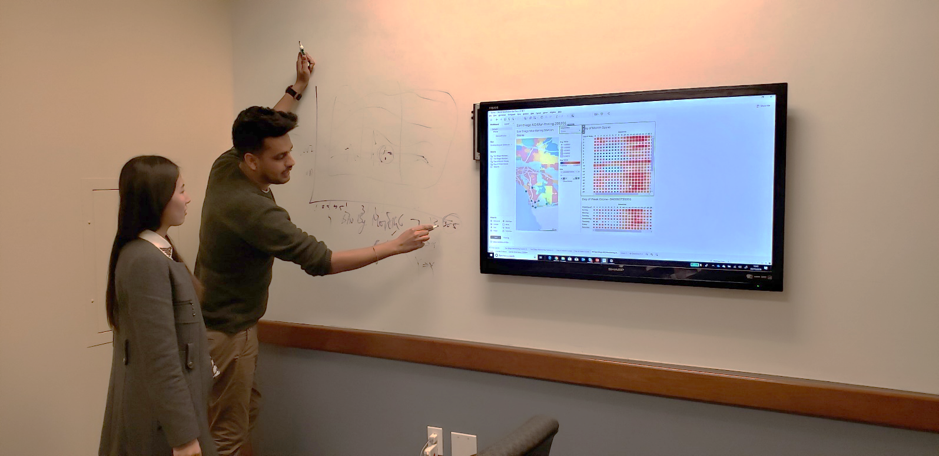




Our Team 206: ET’s NU Analytics Geeks
Notes:
Working together on technical project in big data environment

